Slide 1

HOOKED: UNMASKING THE CRELAN BANK PHISHING ATTACK

Slide 2

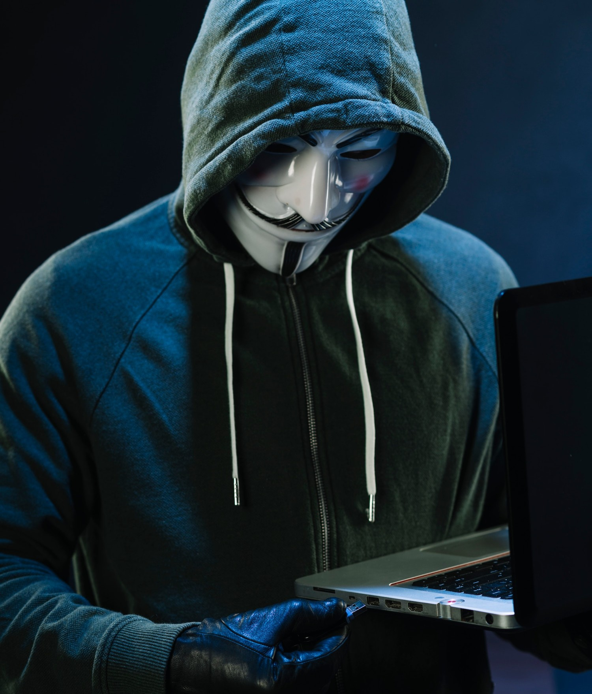
INTRODUCTION
Unraveling the CRELAN Bank phishing attack and its impact on cybersecurity. Get ready to dive into the world of cybercrime and deception.

Slide 3
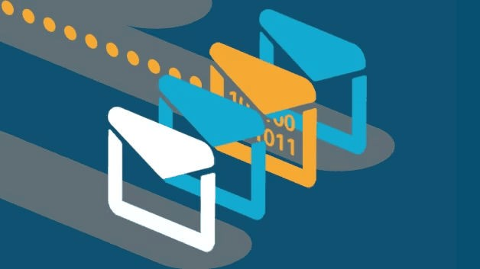
Understand Phishing
Phishing attacks are the practice of sending fraudulent communications that appear to come from a reputable source.
It is usually done through email. The goal is to steal sensitive data like credit card and login information, or to install malware on the victim’s machine. Phishing is a common type of cyber attack that everyone should learn about in order to protect themselves.

Slide 4

ThTheeCCRRELEALANNBBanaknkInInciicddeenntt
Unmasking the intricacies of the sophisticated phishing attack on CRELAN Bank. Analyzing the methods used and the impact on the ﬁnancial institution.

Slide 5

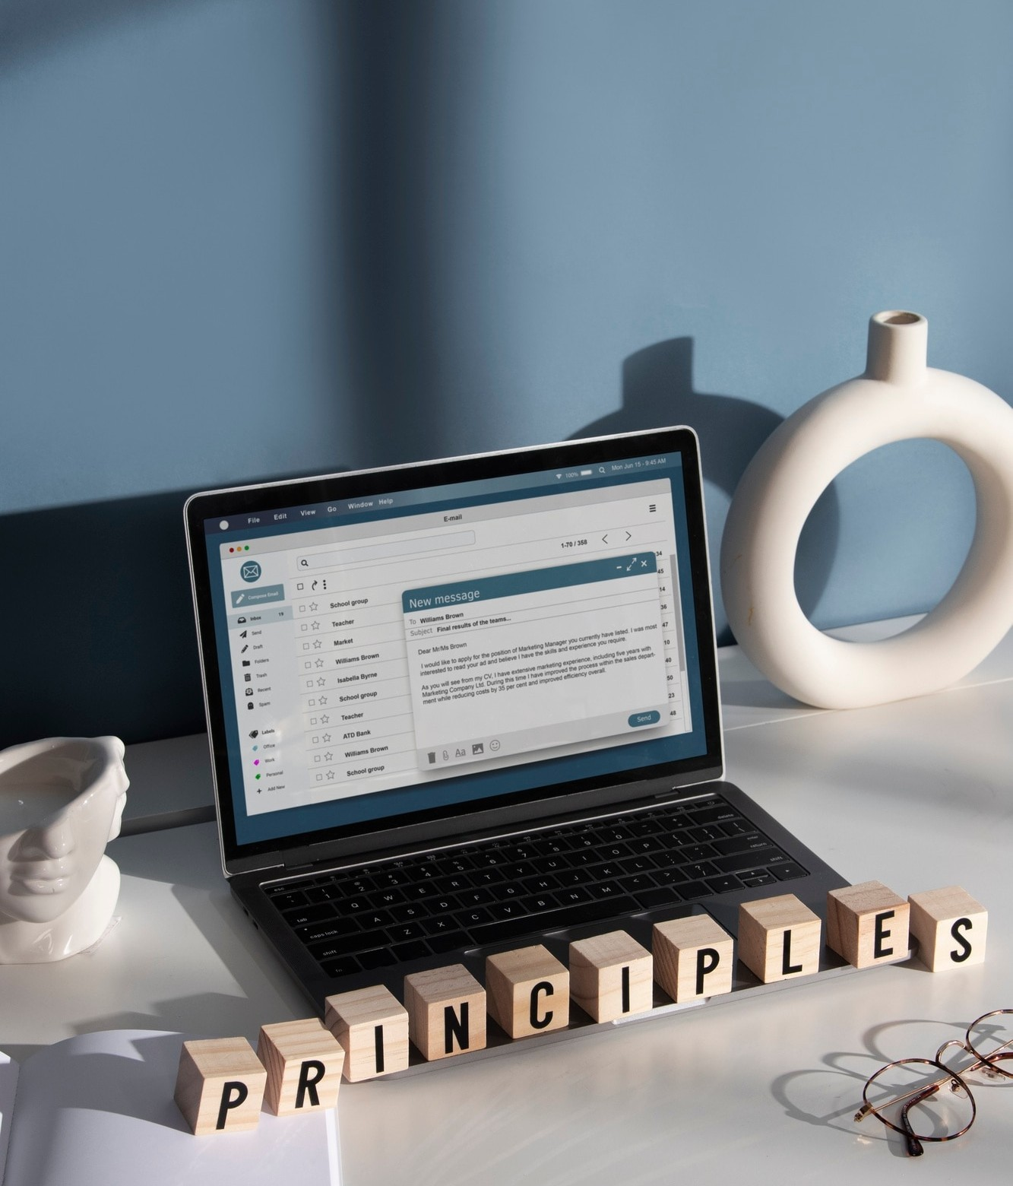
DECEPTIVE EMAILS
Examining the anatomy of
fraudulent emails used in the attack. Identifying the red ﬂags and warning signs to watch out for in email communications.

Slide 6

Social Engineering Tactics
Unveiling the psychological manipulation techniques employed by cybercriminals. Understanding how human behavior is exploited in phishing schemes.

Slide 7

CYBERSECURITY BEST PRACTICES
Empowering individuals and organizations with proactive security measures to combat phishing attacks.
Implementing strategies to safeguard against cyber threats.

Slide 8

IMPACT ON CRELAN BANK
Assessing the repercussions of the phishing attack on CRELAN Bank. Exploring the ﬁnancial, reputational, and regulatory implications of the security breach.
Crelan Bank lost €7.5 million. The attack damaged the bank's reputation.
The attack caused stress and anxiety for employees.

Slide 9


Response
Crelan Bank reported the attack to the authorities.
The bank took steps to improve its security, such as employee training and security awareness programs.
The bank also worked to recover the stolen funds.

Slide 10




Businesses need to be aware of the risk of BEC attacks.
Lessons Learned
Employees need to be trained on how to identify and avoid phishing emails.
Businesses need to
have security in place.
strong measures

Slide 11


1.Ofﬁcial Statements: Look for ofﬁcial
Resources
statements or press releases from Crelan
Bank regarding the incident. These may provide insights into the nature of the attack, its impact, and the actions taken by the bank in response.
2.News Articles: Search for news articles from reputable sources that report on the phishing attack. These articles may
offer additional details, analysis, and perspectives on the incident.
3.Cybersecurity Reports: Explore cybersecurity reports or analyses from
industry-leading organizations or cybersecurity ﬁrms. These reports may provide insights into trends, patterns, and best practices related to phishing attacks
in the banking sector.

Slide 12

CONCLUSION
Reﬂecting on the lessons learned from the CRELAN Bank phishing attack. Emphasizing the importance of vigilance and continuous efforts to combat cybercrime.

Slide 13


